Slide 1
Impositioning
PrintNet T

Slide 2
Agenda
Impositioning (Theory)
Practice

Slide 3

What Is Impositioning?
Used to transform pages (rotating, scaling, moving), create booklets, add marks, mix pages, re-order pages, and other perform other pre-printing functions.
All this can be done without the need of changes to the Layout design.
For such jobs, PrintNet T has many different impositioning modules.

Slide 4
What Is Impositioning?
Workflow
Data Input
&
Manipulation
Document
Design
(Layout)
Impositioning
Approval (Proof)
Spool Production

Slide 5
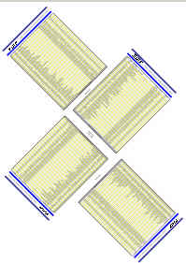
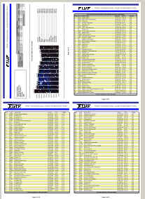
When to Use Impositioning?
In production printing, if several pages are to be printed on one physical sheet (N-Up).
The media sheet may be cut or folded later on during finishing – we need to position them.
If you need to change page order on printer.
If you need to group pages based on variables.

Slide 6

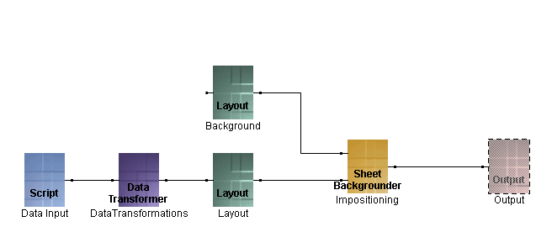
Position in Workflow
Data input
Specific output/s
Impositioning
Page design
Data transformations

Slide 7

What to Keep in Mind?
SheetName variables must be set in Layout if you want to add logic based on variables.
Grouping is Record-based, by default. To change grouping we use group-oriented impositioning modules. Groups can be used in production to split output, etc.

Slide 8

Impositioning and Output Module
In the impositioning module, you tell PrintNet T how many sheets will be “up” on the press.
However, you set the page size for the job in the output module.
The page size settings in the impositioning module must be the same as the page size setting in the output module.

Slide 9
Pivot Point
In PrintNet T, the impositioning modules set the (0,0) point on the top, left corner of the page.
When you enter settings in any impositioning module, the module bases measurement on the pivot point at the top left corner of the page.

Slide 10
Most Common Impositioning Modules
Module | Short Description
Transformer | You can set parameters to: rotate pages; change their scaling and set horizontal and vertical offsets.
N-Up | Sets up the document for printing multiple pages per sheet with definable offsets and counts in either direction.
NS-Splitter | North/South split positioning of the pages within the sheets. You can set count and offset in both axes. See Sheet NS Splitter description.
Regrouper | Regroups sheets, based on given criteria such as group name change or group count.

Slide 11
Impositioning Types
Module | Type
Sheet Backgrounder Sheet Padder Sheet Inserter Sheet Sorter Marks Inserter Region Binder Media Pattern Filter Impositioning Script | Misc. Ordering Ordering Ordering Transformation Ordering Ordering Misc.

Slide 12
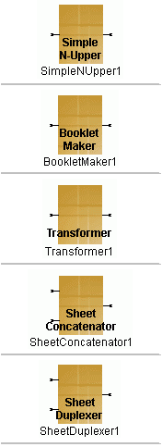
Modules Description I
Sets up the document for printing multiple pages per sheet.
Produces brochures, books, etc.
Modifies output.
Concatenates the output of the layouts.
Upper Layout is printed on front page and second Layout is printed on back page.
Notes:
Sets up the document for printing multiple pages per sheet with definable offsets and counts in either direction.
Produces brochures, books, etc. You use this module to position, scale, and rotate pages within the output sheet(s) for a different range of input pages.
Modifies output. You can set parameters to: rotate pages; change the scaling of either axis (independently); and set both horizontal and vertical offsets.
Concatenates the output of the layouts. All the pages of the first layout are printed first, then pages from the second layout are appended. This module is not configurable.
Upper Layout is printed on front Page and second is printed on back page. Repeating is configurable.

Slide 13
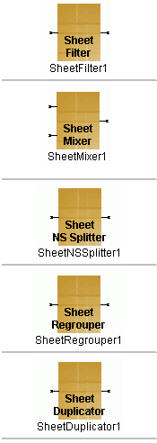
Modules Description II
The Sheet Filter module enables users to pass sheets that meet specified group size or name criteria.
The Sheet Mixer places the content of two designed layouts together into a single layout.
North/South split positioning of the pages within the sheets. You can set count and offset in both axes.
Regroups sheets, based on given criteria – Sheet or Group count or SheetName change/condition.
Based on associated SheetName. Pages in the group are duplicated as many times as the value of SheetName variable on the first page of the group.
Notes:
The Sheet Filter module enables you to pass on to the output (or keep from passing to the output) only those sheets that meet specified group size or name criteria.
The Sheet Mixer places the content of two designed layouts together into a single layout. The content from one layout design is placed over the other. The two independent layouts may even have separate data input files. There are no options associated with this module.
North/South split positioning of the pages within the sheets. You can set count and offset in both axes.
Regroups sheets, based on given criteria – Sheet or Group count or SheetName change/condition.
Based on associated SheetName. Pages in the group are duplicated as many times as the value of SheetName variable on the first page of the group.

Slide 14
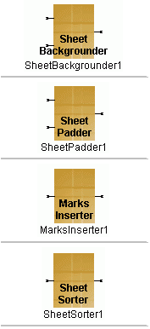
Modules Description III
The Sheet Backgrounder module merges two layouts.
The Sheet Padder is used to fill pages to specified PageCount.
The Marks Inserter module enables you to insert targets and/or squares of the size and in the position you specify.
Sheet Sorter sorts sheets by SheetName variable from each sheet within one group; or it sorts groups by the first Sheet SheetName variable in every group.
Notes:
The Sheet Backgrounder module merges two layouts. The layout connected to the top connector presents the background and is printed first. The layout connected to the bottom connector is printed over the background.
The Sheet Padder is used to fill pages to specified PageCount. Ex. when you duplex a job and wish to ensure that the last page of a document ends on an even numbered page.
The Marks Inserter module enables you to insert targets and/or squares of the size and in the position you specify.
Sheet sorter can be used in two ways:
It sorts sheets by SheetName variable from each sheet within one group .
It sorts groups by the first Sheet SheetName variable in every group.

Slide 15
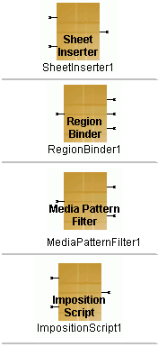
Modules Description IV
The Sheet Inserter module inserts all sheets from the layout connected to second input.
The Region Binder module enables the sorting of envelopes according to their zip code and weight.
The purpose of this module is to filter the incoming sheets according to their pattern sequence.
Fully programmable positioning module. You can define multiple input and output nodes.
Notes:
The Sheet Inserter module inserts all sheets from the layout connected to second input before or after every n sheet; or before or after every n group (records).
The Region Binder module enables the sorting of envelopes according to their zip code and weight. It is customer specific and needs special configuration before use.
The purpose of this module is to filter the incoming sheets according to their pattern sequence. Whatever passes through the sequence goes to first output, all others to second one.
Fully programmable positioning module. You can define multiple input and output nodes, work with groups, SheetNames, and page layers.

Slide 16
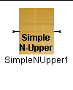
Impositioning – Simple N-Upper
Sets up the document for printing multiple pages per sheet with definable offsets and counts in either direction.

Slide 17
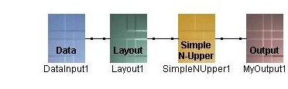
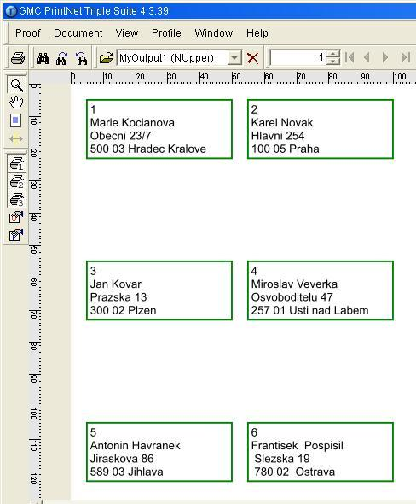
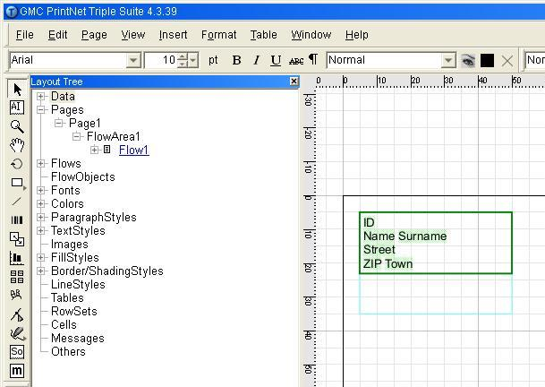
Simple N-Upper – Example
Layout
Output

Slide 18



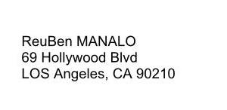
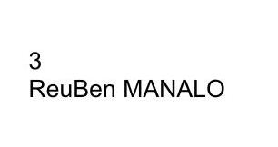
Simple N-Upper – Exercise
Side 1
Side 2

Slide 19

Thank You.
Do You Have Any Questions?

